Slide 1
ST 522/532 Final Project
By: Will Davis, Grant Corkren, and Chloe Drummond

Slide 2
Introduction
4 Data sets: flights, airlines, hubs, and airports
Flights: 31 variables and roughly 5.8 million observations
Airlines: 2 variables and 14 observations
Hubs: 2 variables and 15 observations
Airports: 7 variables and 322 observations
The focus of this analysis is to predict cancellations

Slide 3
Data Management
The initial sample given only contained 2% cancellations
As a result, models using the original date would very rarely predict a cancellation, and thus we chose to resample
Our new sample contained a 50/50 split of cancellations and non-cancellations
Predictor variables were assessed for potential correlations and missing values

Slide 4
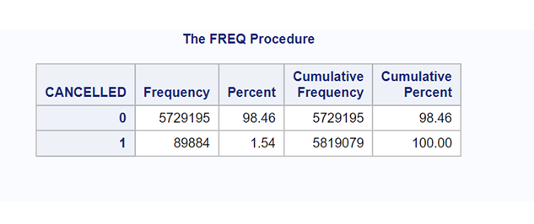
Class imbalance
Most of the dataset consisted of flights that were not canceled. This skewed the models to predict that a flight would not be canceled. This led to models having a misclassification rate of two percent, which is good, but does not give us any valuable information.

Slide 5
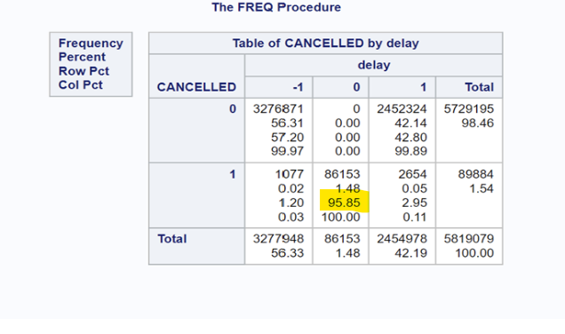
All Delay variables were rejected
Missing value=0
Departure before scheduled time= -1
Departure on time or after scheduled time =1
This variable could skew the model to predict a canceled flight when the variable is missing.

Slide 6
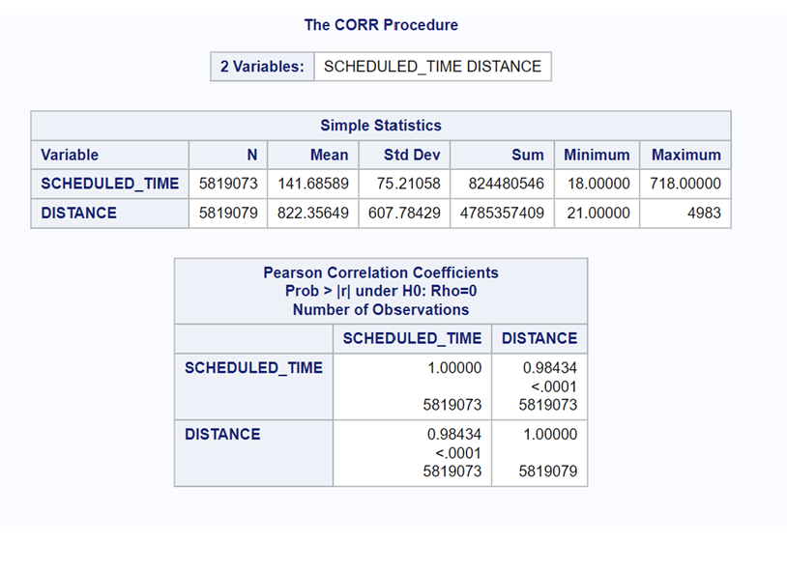
Correlation of distance and scheduled time
Schedule_time was rejected from the set of predictors since the correlation was high.

Slide 7
Models used to predict flight cancellation
The analysis utilized neural networks, regression models, and decision trees
4 neural networks were built with 3, 5, 10, and 25 hidden units
Optimal decision tree and random forest (bagging and boosting)
6 logistic regression models and 2 regression ensemble models

Slide 8
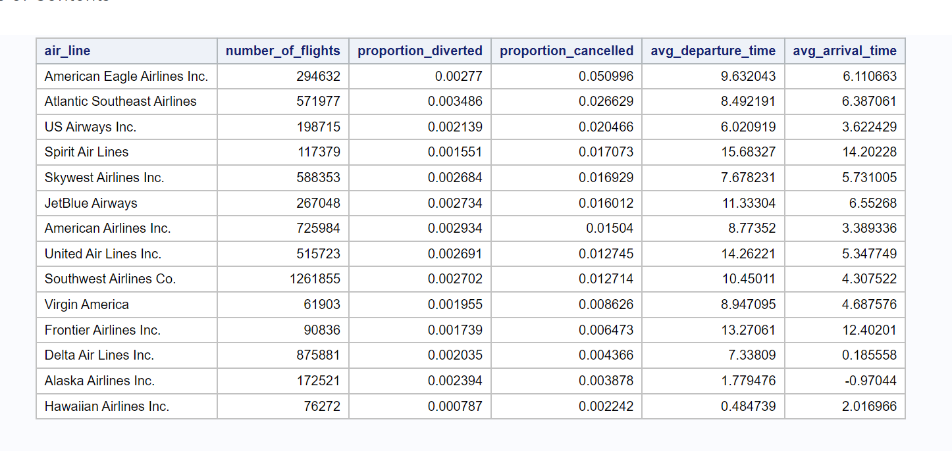
Airline summary table

Slide 9
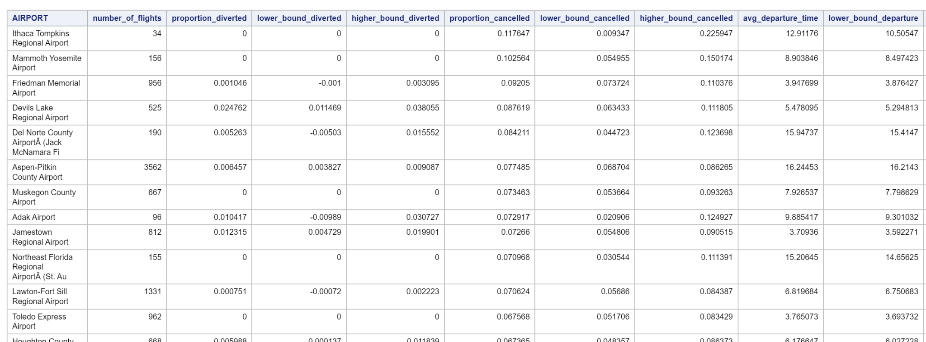
Airport summary table

Slide 10
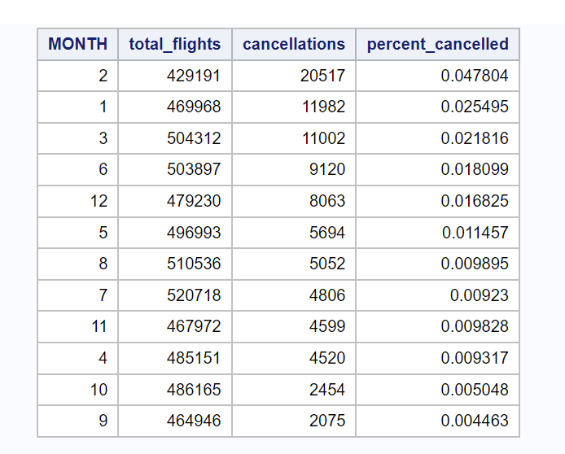
Cancellation by month

Slide 11
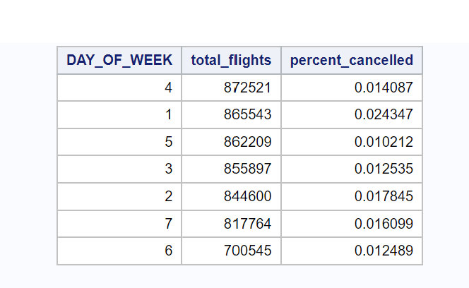
Cancellation by day of the day

Slide 12
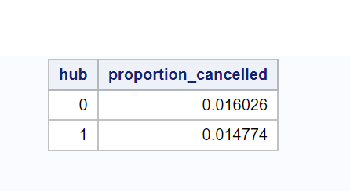
Cancellation of a flight given the flight is taking off at the airline’s hub or not
Hub=1 – The flight took off from the flight’s airline hub
A hypothesis of difference of two proportions showed a p-value < 0.0001.
This means a flight is less likely to be canceled if it is taking off from its hub than from an airport that is not the hub for the airline associated with the flight.

Slide 13
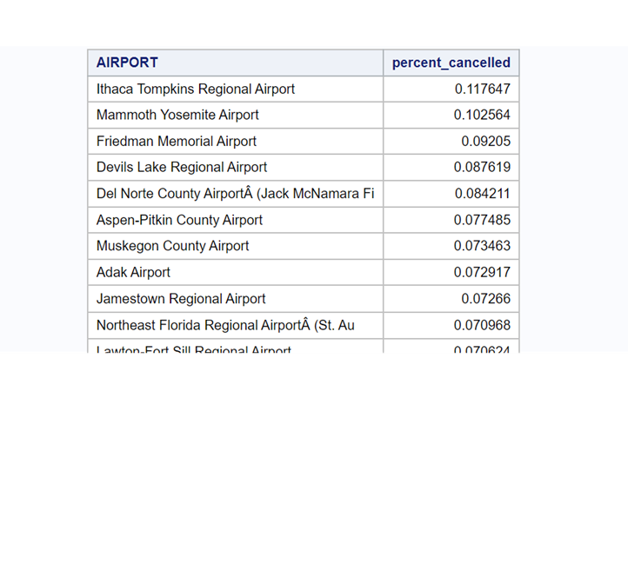
Airport subquery for above average percent cancelled

Slide 14
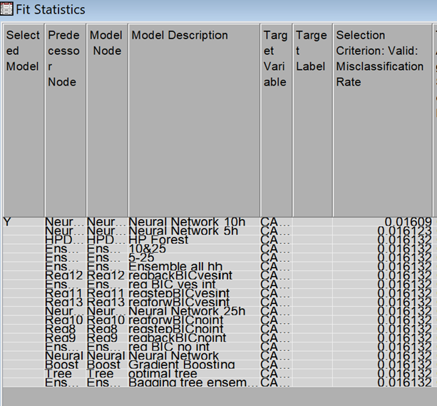
Original sample

Slide 15
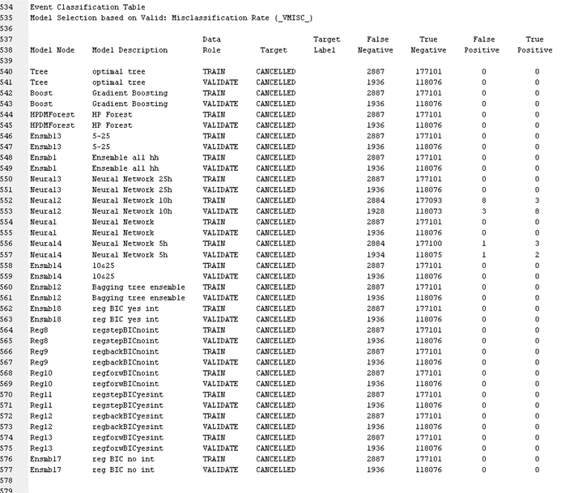
Models fitted from the original dataset only predicted that the flights would not be canceled, except for a few neural network models which each predicted very few cancellations.

Slide 16
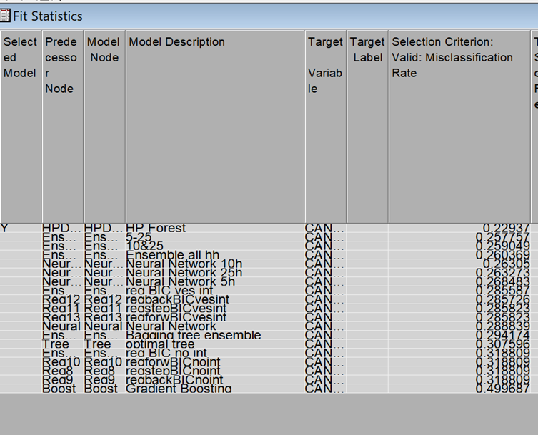
50/50 without prior probability

Slide 17
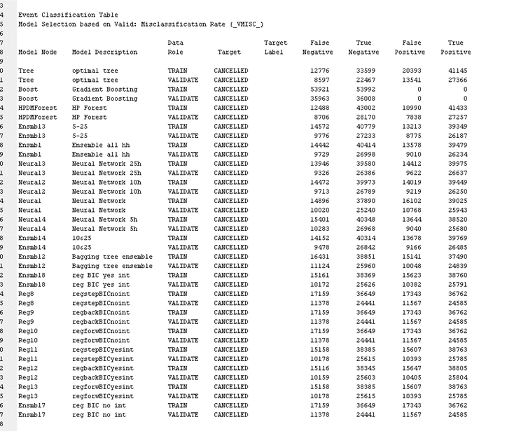

Slide 18
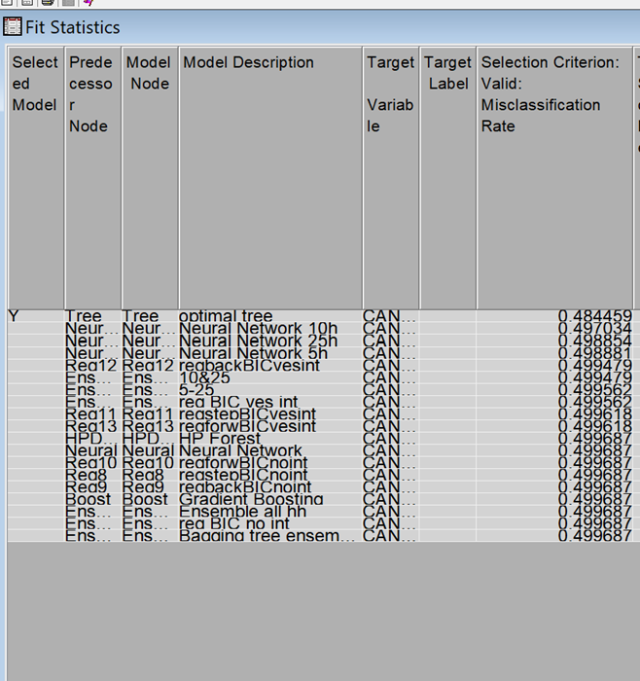
50/50 with prior probability

Slide 19
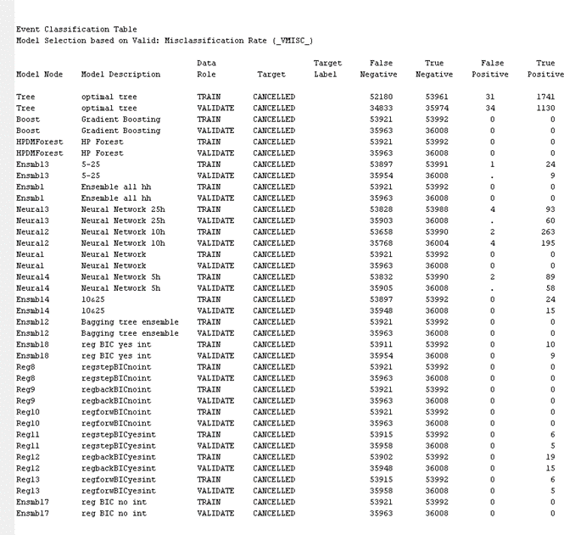
Models with modified sample
The false negatives of these models are high but high because it is accounting for prior probability from the original sample. The models are now predicting flight cancellations (true positives).

Slide 20
Results/Discussion
Original sample: true positive rate 0.41% and true negative rate 100%
New sample with prior: true positive rate 3.41% and true negative rate 99.91%
Better quality data (less to no missing values) and better variables would drive a more accurate analysis
50/50 split with no prior probability best model misclassification rate is .22

